Slide 1

8051 Instruction Set
Professor Yasser Kadah – www.k-space.org

Slide 2
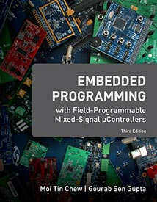
Recommended Reference
Embedded Programming with Field Programmable Mixed Signal μController, M.T. Chew and G.S. Gupta.

Slide 3

8051 Instruction Set
Introduction
CIP-51 architecture and memory organization review
Addressing Modes
Register addressing
Direct addressing
Indirect addressing
Immediate constant addressing
Relative addressing
Absolute addressing
Long addressing
Indexed addressing
Instruction Types
Arithmetic operations
Logical operations
Data transfer instructions
Boolean variable instructions
Program branching instructions
Notes:
In this lecture we will look at the various addressing modes and the instructions.

Slide 4
Introduction
A computer instruction is made up of an operation code (op-code) followed by either zero, one or two bytes of operands
The op-code identifies the type of operation to be performed while the operands identify the source and destination of the data
The operand can be:
The data value itself
A CPU register
A memory location
An I/O port
If the instruction is associated with more than one operand, the format is always:
Instruction Destination, Source
Notes:
An instruction is made up of an operation code (op-code) followed by operand(s). The operand can be one of these- data to operate on, CPU register, memory location or an I/O port.

Slide 5
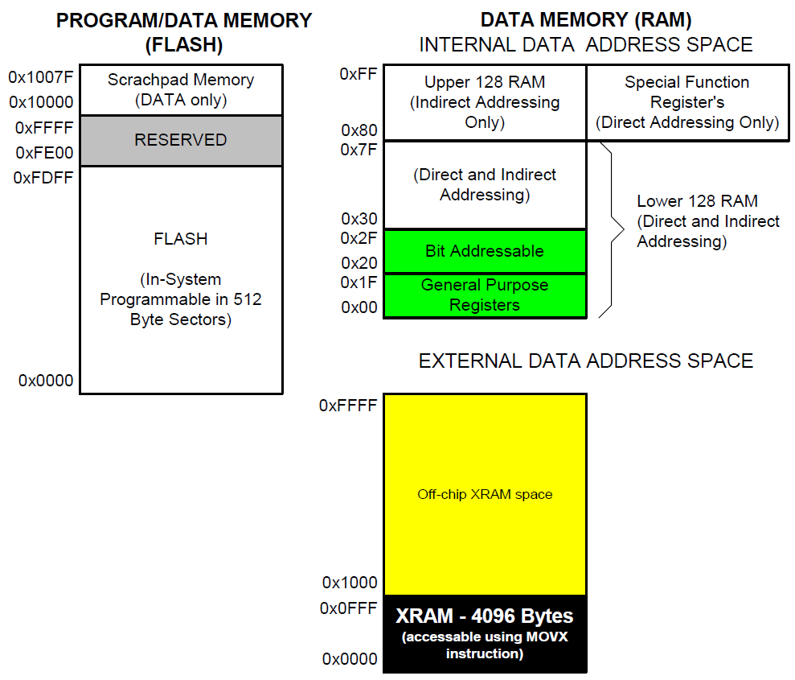
Memory Organization
The memory organization of C8051F020 is similar to that of a standard 8051
Program and data memory share the same address space but are accessed via different instruction types
Notes:
The memory organisation of C8051F020 is very similar to that of the basic 8051, especially the internal data memory and its layout in terms of register banks, bit-addressable space and location of SFRs.

Slide 6
Addressing Modes
Eight modes of addressing are available with the C8051F020
The different addressing modes determine how the operand byte is selected
Addressing Modes | Instruction
Register | MOV A, B
Direct | MOV 30H,A
Indirect | ADD A,@R0
Immediate Constant | ADD A,#80H
Relative* | SJMP AHEAD
Absolute* | AJMP BACK
Long* | LJMP FAR_AHEAD
Indexed | MOVC A,@A+PC
* Related to program branching instructions
Notes:
There are 8 addressing modes. The addressing mode determines how the operand byte is selected.

Slide 7
Register Addressing
The register addressing instruction involves information transfer between registers
Example:
MOV R0, A
The instruction transfers the accumulator content into the R0 register.
Notes:
In the Register Addressing mode, the instruction involves transfer of information between registers.
The accumulator is referred to as the A register.

Slide 8
Direct Addressing
This mode allows you to specify the operand by giving its actual memory address (typically specified in hexadecimal format) or by giving its abbreviated name (e.g. P3)
Note: Abbreviated SFR names are defined in the “C8051F020.inc” header file
Example:
MOV A, P3 ;Transfer the contents of ;Port 3 to the accumulator
MOV A, 020H ;Transfer the contents of RAM ;location 20H to the accumulator
Notes:
In Direct Addressing mode you specify the operand by giving its actual memory address (in Hexadecimal) or by giving its abbreviated name (e.g. P3).

Slide 9
Indirect Addressing
This mode uses a pointer to hold the effective address of the operand
Only registers R0, R1 and DPTR can be used as the pointer registers
The R0 and R1 registers can hold an 8-bit address, whereas DPTR can hold a 16-bit address
Examples:
MOV @R0,A ;Store the content of ;accumulator into the memory ;location pointed to by ;register R0. R0 could have an ;8-bit address, such as 60H.
MOVX A,@DPTR ;Transfer the contents from ;the memory location ;pointed to by DPTR into the ;accumulator. DPTR could have a ;16-bit address, such as 1234H.
Notes:
In the Indirect Addressing mode, a register is used to hold the effective address of the operand. This register, which holds the address, is called the pointer register and is said to point to the operand.
Only registers R0, R1 and DPTR can be used as pointer registers.
R0 and R1 registers can hold an 8-bit address whereas DPTR can hold a 16-bit address. DPTR is useful in accessing operands which are in the external memory.

Slide 10
Immediate Constant Addressing
This mode of addressing uses either an 8- or 16-bit constant value as the source operand
This constant is specified in the instruction, rather than in a register or a memory location
The destination register should hold the same data size which is specified by the source operand
Examples:
ADD A,#030H ;Add 8-bit value of 30H to
;the accumulator register
;(which is an 8-bit register).
MOV DPTR,#0FE00H ;Move 16-bit data constant ;FE00H into the 16-bit Data ;Pointer Register.
Notes:
In the Immediate Constant Addressing mode, the source operand is an 8- or 16-bit constant value.
This constant is specified in the instruction itself (rather than in a register or a memory location).
The destination register should hold the same data size which is specified by the source operand.

Slide 11
Relative Addressing
This mode of addressing is used with some type of jump instructions, like SJMP (short jump) and conditional jumps like JNZ
These instructions transfer control from one part of a program to another
The destination address must be within -128 and +127 bytes from the current instruction address because an 8-bit offset is used (2⁸ = 256)
Example:
GoBack: DEC A ;Decrement A
JNZ GoBack ;If A is not zero, loop back
Notes:
The Relative Addressing mode is used with some type of jump instructions like SJMP (short jump) and conditional jumps like JNZ. This instruction transfers control from one part of a program to another.

Slide 12
Absolute Addressing
Two instructions associated with this mode of addressing are ACALL and AJMP instructions
These are 2-byte instructions where the 11-bit absolute address is specified as the operand
The upper 5 bits of the 16-bit PC address are not modified. The lower 11 bits are loaded from this instruction. So, the branch address must be within the current 2K byte page of program memory (2¹¹ = 2048)
Example:
ACALL PORT_INIT ;PORT_INIT should be ;located within 2k bytes.
PORT_INIT: MOV P0, #0FH ;PORT_INIT subroutine
Notes:
In Absolute Addressing mode, the absolute address, to which the control is transferred, is specified by a label. Two instructions associated with this mode of addressing are ACALL and AJMP instructions. These are 2-byte instructions.

Slide 13
Long Addressing
This mode of addressing is used with the LCALL and LJMP instructions
It is a 3-byte instruction and the last 2 bytes specify a 16-bit destination location where the program branches
It allows use of the full 64 K code space
The program will always branch to the same location no matter where the program was previously
Example:
LCALL TIMER_INIT ;TIMER_INIT address (16-bits ;long) is specified as the ;operand; In C, this will be a ;function call: Timer_Init().
TIMER_INIT: ORL TMOD,#01H ;TIMER_INIT subroutine
Notes:
This mode of addressing is used with the LCALL and LJMP instructions. It is a 3-byte instruction and the last 2 bytes specify a 16-bit destination location where the program branches to. It allows use of the full 64K code space.

Slide 14
Indexed Addressing
The Indexed addressing is useful when there is a need to retrieve data from a look-up table
A 16-bit register (data pointer) holds the base address and the accumulator holds an 8-bit displacement or index value
The sum of these two registers forms the effective address for a JMP or MOVC instruction
Example:
MOV A,#08H ;Offset from table start
MOV DPTR,#01F00H ;Table start address
MOVC A,@A+DPTR ;Gets target value from the table ;start address + offset and puts it ;in A.
After the execution of the above instructions, the program will branch to address 1F08H (1F00H+08H) and transfer into the accumulator the data byte retrieved from that location (from the look-up table)
Notes:
The Indexed addressing is useful when there is a need to retrieve data from a look-up table (LUT). A 16-bit register (data pointer) holds the base address and the accumulator holds an 8-bit displacement or index value. The sum of these two registers forms the effective address for a JMP or MOVC instruction.

Slide 15
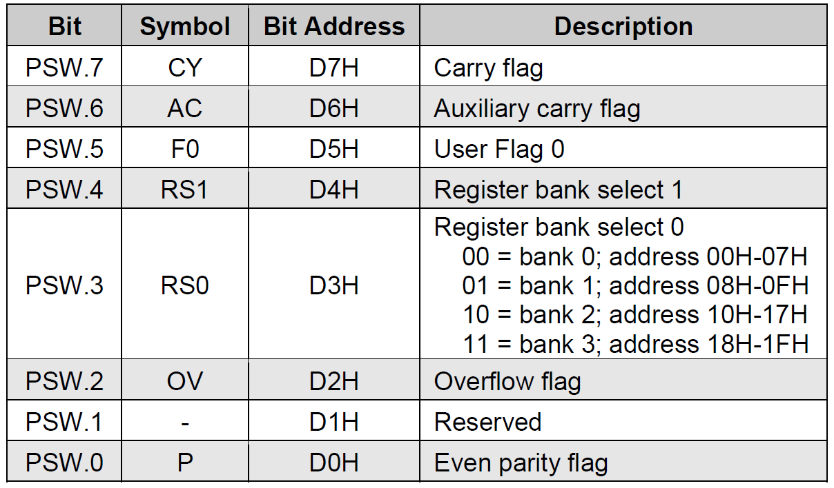
Program Status Word (PSW)

Slide 16


Program Status Word (PSW)
Carry Flag (CY)
Set if there is a carry out of bit 7 during an addition operation
Set if there is a borrow into bit 7 during a subtraction operation
Example: if accumulator A=F1H, then the instruction,
leaves a value of 00H in the accumulator and sets the carry flag in PSW (PSW.7)
Extensively used as a 1-bit register in Boolean operations on bit-valued data.

Slide 17
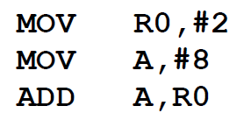
Program Status Word (PSW)
Auxiliary Carry Flag (AC)
When adding binary coded decimal (BCD) values, AC is set if a carry was generated out of bit 3 into bit 4 or if the result in the lower nibble is in the range 0AH to 0FH.
Example, the following instruction sequence will result in the auxiliary carry flag being set:

Slide 18
Program Status Word (PSW)
Overflow Flag (OV)
Set after an addition or subtraction operation if there is an arithmetic overflow (the result is out of range for the data size)
When signed numbers are added or subtracted, a program can test this bit to determine if the result is in the proper range.
For 8-bit signed numbers, the result should be in the range of +127 to –128)
Even Parity Flag (P)
Number of ‘1’ bits in accumulator plus P is always even
P is automatically set or cleared to establish even parity with the accumulator.
Example: if accumulator contains 00101100B then P is set to 1
Example: if accumulator contains 01101100B then P is reset to 0

Slide 19
Instruction Types
The C8051F020 instructions are divided into five functional groups:
Arithmetic operations
Logical operations
Data transfer operations
Boolean variable operations
Program branching operations
Notes:
The C8051F020 instructions are divided into five functional groups. We will discuss each group separately.

Slide 20
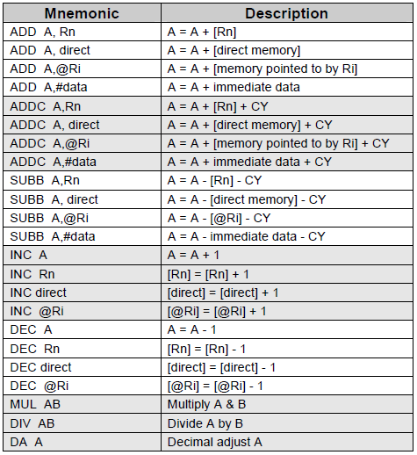
Arithmetic Operations
Appropriate status bits in the PSW are set when specific conditions are met, which allows the user software to manage the different data formats
[@Ri] implies contents of memory location pointed to by R0 or R1
Rn refers to registers R0-R7 of the currently selected register bank
Notes:
This group of operators perform arithmetic operations. Arithmetic operations effect the flags, such as Carry Flag (CY), Overflow Flag (OV) etc, in the PSW register.

Slide 21
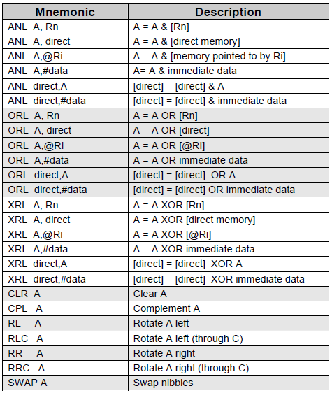
Logical Operations
Logical instructions perform Boolean operations (AND, OR, XOR, and NOT) on data bytes on a bit-by-bit basis
Examples:
ANL A, #02H ;Mask bit 1
ORL TCON, A ;TCON=TCON-OR-A
Notes:
Logical instructions perform standard Boolean operations such as AND, OR, XOR, NOT (compliment). Other logical operations are clear accumulator, rotate accumulator left and right, and swap nibbles in accumulator.

Slide 22
Data Transfer Instructions
Data transfer instructions can be used to transfer data between an internal RAM location and an SFR location without going through the accumulator
It is also possible to transfer data between the internal and external RAM by using indirect addressing
The upper 128 bytes of data RAM are accessed only by indirect addressing and the SFRs are accessed only by direct addressing
Mnemonic | Description
MOV @Ri, direct | [@Ri] = [direct]
MOV @Ri, #data | [@Ri] = immediate data
MOV DPTR, #data 16 | [DPTR] = immediate data
MOVC A,@A+DPTR | A = Code byte from [@A+DPTR]
MOVC A,@A+PC | A = Code byte from [@A+PC]
MOVX A,@Ri | A = Data byte from external ram [@Ri]
MOVX A,@DPTR | A = Data byte from external ram [@DPTR]
MOVX @Ri, A | External[@Ri] = A
MOVX @DPTR,A | External[@DPTR] = A
PUSH direct | Push into stack
POP direct | Pop from stack
XCH A,Rn | A = [Rn], [Rn] = A
XCH A, direct | A = [direct], [direct] = A
XCH A, @Ri | A = [@Rn], [@Rn] = A
XCHD A,@Ri | Exchange low order digits
Notes:
Data transfer instructions are used to transfer data between an internal RAM location and SFR location without going through the accumulator. Data can also be transferred between the internal and external RAM by using indirect addressing.

Slide 23
Boolean Variable Instructions
The C8051F020 processor can perform single bit operations
The operations include set, clear, and, or and complement instructions
Also included are bit–level moves or conditional jump instructions
All bit accesses use direct addressing
Examples:
;Start Timer0.
SETB TR0
;Wait till timer overflows.
POLL: JNB TR0, POLL
Mnemonic | Description
CLR C | Clear C
CLR bit | Clear direct bit
SETB C | Set C
SETB bit | Set direct bit
CPL C | Complement c
CPL bit | Complement direct bit
ANL C,bit | AND bit with C
ANL C,/bit | AND NOT bit with C
ORL C,bit | OR bit with C
ORL C,/bit | OR NOT bit with C
MOV C,bit | MOV bit to C
MOV bit,C | MOV C to bit
JC rel | Jump if C set
JNC rel | Jump if C not set
JB bit,rel | Jump if specified bit set
JNB bit,rel | Jump if specified bit not set
JBC bit,rel | if specified bit set then clear it and jump
Notes:
The Boolean Variable operations include set, clear, as well as and, or and complement instructions. Also included are bit–level moves or conditional jump instructions. All bit accesses use direct addressing.

Slide 24
Program Branching Instructions
Mnemonic | Description
ACALL addr11 | Absolute subroutine call
LCALL addr16 | Long subroutine call
RET | Return from subroutine
RETI | Return from interrupt
AJMP addr11 | Absolute jump
LJMP addr16 | Long jump
SJMP rel | Short jump
JMP @A+DPTR | Jump indirect
JZ rel | Jump if A=0
JNZ rel | Jump if A NOT=0
CJNE A,direct,rel | Compare and Jump if Not Equal
CJNE A,#data,rel
CJNE Rn,#data,rel
CJNE @Ri,#data,rel
DJNZ Rn,rel | Decrement and Jump if Not Zero
DJNZ direct,rel
NOP | No Operation
Program branching instructions are used to control the flow of program execution
Some instructions provide decision making capabilities before transferring control to other parts of the program (conditional branches).
Notes:
Program branching instructions are used to control the flow of actions in a program. Some instructions provide decision making capabilities and transfer control to other parts of the program e.g. conditional and unconditional branches.

Slide 25
www.silabs.com/MCU
Labs and Problem Sets available at:
www.k-space.org

